Slide 1

ELIXIR-EXCELERATE Train The Trainer

Slide 2
Why are we here?
Learning principles
Training techniques
Lesson, session, course, and material design
Assessment and feedback
Notes:
To get acquainted with learning principles and how they apply to training
To be able to select and utilise training techniques that can be used to enhance learner engagement and participation
To learn about session, course, and materials design
To learn how to use assessment and feedback in training

Slide 3
Session 1: Principles of learning and how they apply to training
Session 2: Training techniques that can be used to enhance learner engagement and participation
Session 3: Session, course, and materials design
Session 4: Assessment and feedback in training

Slide 4
Learning results from what the student does and thinks and only from what the student does and thinks. The teacher can advance learning only by influencing what the student does to learn
H.A. Simon (one of the founders of the field of
Cognitive Science and Nobel Laureate) 1916-2001

Slide 5
We cannot talk about teaching, teaching practices or effective teaching techniques if we don't understand first how people learn

Slide 6
How learning works
Challenge: How do you go about learning something new ? How do you approach learning new things? (3 min + 5 min)
Read about it
Attend a training session !
Have a go ?
Do, reflect, process, further understand?
Which is the most effective approach for *you* to learn?
Make a list of three approaches that work for you when you want to learn something new (from the most to the less effective one). Discuss it with your partner and compare.

Slide 7
What is learning?
From Ambrose et al. (2010) "How learning works":
Learning is not a product but a process occurring in the mind. As such, we can only infer that it has occurred from students' products or performance
Learning involves change in knowledge, beliefs, behaviours, or attitudes
Learning is not something done to students, but rather something students themselves do.
From Willingham (2009) "Why don't students like school?":
Learning is a change in the long term memory

Slide 8
What is learning?
From Ambrose et al. (2010) "How learning works":
Learning is not a product but a process occurring in the mind. As such, we can only infer that it has occurred from students' products or performance
Learning involves change in knowledge, beliefs, behaviours, or attitudes
Learning is not something done to students, but rather something students themselves do.
From Willingham (2009) "Why don't students like school?":
Learning is a change in the long term memory

Slide 9
What is learning?
From Ambrose et al. (2010) "How learning works":
Learning is not a product but a process occurring in the mind. As such, we can only infer that it has occurred from students' products or performance
Learning involves change in knowledge, beliefs, behaviours, or attitudes
Learning is not something done to students, but rather something students themselves do.
From Willingham (2009) "Why don't students like school?":
Learning is a change in the long term memory

Slide 10
What is learning?
From Ambrose et al. (2010) "How learning works":
Learning is not a product but a process occurring in the mind. As such, we can only infer that it has occurred from students' products or performance
Learning involves change in knowledge, beliefs, behaviours, or attitudes
Learning is not something done to students, but rather something students themselves do.
From Willingham (2009) "Why don't students like school?":
Learning is a change in the long term memory

Slide 11
How learning works
What is learning?
Which learning theory?

Slide 12
How learning works: Seven research-based principles for smart teaching (Ambrose, et al. 2010)
Principle P1: Students' prior knowledge can help or hinder learning.
Principle P2: How students organise knowledge influences how they learn and apply what they know.
Principle P3: Students motivation determines, directs and sustains what they do learn.
Principle P4: To develop mastery, students must acquire component skills, practice integrating them, and know when to apply what they have learned
Principle P5: Goal-directed practice coupled with targeted feedback enhances the quality of students' learning
Principle P6: Students' current level of development interacts with the social, emotional, and intellectual climate of the course to impact learning
Principle P7: To become self-directd leaners, students must learn to monitor and adjust their approaches to learning.

Slide 13
How learning works: Seven research-based principles for smart teaching (Ambrose, et al. 2010)
Principle P1: Students' prior knowledge can help or hinder learning.
Principle P2: How students organise knowledge influences how they learn and apply what they know.
Principle P3: Students motivation determines, directs and sustains what they do learn.
Principle P4: To develop mastery, students must acquire component skills, practice integrating them, and know when to apply what they have learned
Principle P5: Goal-directed practice coupled with targeted feedback enhances the quality of students' learning
Principle P6: Students' current level of development interacts with the social, emotional, and intellectual climate of the course to impact learning
Principle P7: To become self-directd leaners, students must learn to monitor and adjust their approaches to learning.

Slide 14
How learning works: Seven research-based principles for smart teaching (Ambrose, et al. 2010)
Principle P1: Students' prior knowledge can help or hinder learning.
Principle P2: How students organise knowledge influences how they learn and apply what they know.
Principle P3: Students motivation determines, directs and sustains what they do learn.
Principle P4: To develop mastery, students must acquire component skills, practice integrating them, and know when to apply what they have learned
Principle P5: Goal-directed practice coupled with targeted feedback enhances the quality of students' learning
Principle P6: Students' current level of development interacts with the social, emotional, and intellectual climate of the course to impact learning
Principle P7: To become self-directd leaners, students must learn to monitor and adjust their approaches to learning.

Slide 15
How learning works: Seven research-based principles for smart teaching (Ambrose, et al. 2010)
Principle P1: Students' prior knowledge can help or hinder learning.
Principle P2: How students organise knowledge influences how they learn and apply what they know.
Principle P3: Students motivation determines, directs and sustains what they do learn.
Principle P4: To develop mastery, students must acquire component skills, practice integrating them, and know when to apply what they have learned
Principle P5: Goal-directed practice coupled with targeted feedback enhances the quality of students' learning
Principle P6: Students' current level of development interacts with the social, emotional, and intellectual climate of the course to impact learning
Principle P7: To become self-directd leaners, students must learn to monitor and adjust their approaches to learning.

Slide 16
How learning works: Seven research-based principles for smart teaching (Ambrose, et al. 2010)
Principle P1: Students' prior knowledge can help or hinder learning.
Principle P2: How students organise knowledge influences how they learn and apply what they know.
Principle P3: Students motivation determines, directs and sustains what they do learn.
Principle P4: To develop mastery, students must acquire component skills, practice integrating them, and know when to apply what they have learned
Principle P5: Goal-directed practice coupled with targeted feedback enhances the quality of students' learning
Principle P6: Students' current level of development interacts with the social, emotional, and intellectual climate of the course to impact learning
Principle P7: To become self-directd leaners, students must learn to monitor and adjust their approaches to learning.

Slide 17
How learning works: Seven research-based principles for smart teaching (Ambrose, et al. 2010)
Principle P1: Students' prior knowledge can help or hinder learning.
Principle P2: How students organise knowledge influences how they learn and apply what they know.
Principle P3: Students motivation determines, directs and sustains what they do learn.
Principle P4: To develop mastery, students must acquire component skills, practice integrating them, and know when to apply what they have learned
Principle P5: Goal-directed practice coupled with targeted feedback enhances the quality of students' learning
Principle P6: Students' current level of development interacts with the social, emotional, and intellectual climate of the course to impact learning
Principle P7: To become self-directd leaners, students must learn to monitor and adjust their approaches to learning.

Slide 18
How learning works: Seven research-based principles for smart teaching (Ambrose, et al. 2010)
Principle P1: Students' prior knowledge can help or hinder learning.
Principle P2: How students organise knowledge influences how they learn and apply what they know.
Principle P3: Students motivation determines, directs and sustains what they do learn.
Principle P4: To develop mastery, students must acquire component skills, practice integrating them, and know when to apply what they have learned
Principle P5: Goal-directed practice coupled with targeted feedback enhances the quality of students' learning
Principle P6: Students' current level of development interacts with the social, emotional, and intellectual climate of the course to impact learning
Principle P7: To become self-directd leaners, students must learn to monitor and adjust their approaches to learning.

Slide 19
Our pedagogical model is based on the following concepts, ideas, and models:
The difference between teaching and training
Adult learning or andragogy
The Bloom's six categories of cognitive skills
How thinking and memory work
The acquisition of skills: novices, competent practicionners, experts
Cognitive development and mental models
The importance of the learning environment
Active learning

Slide 20
Teaching or Training?
Challenge: Based on your experience, what are in your opinion the differences between teaching and training? (5 min)
Make a list of three main differences. Discuss with your partner(s). Write each on a different sticky note.

Slide 21
Adult learning or andragogy
Challenge: what learner are you today?
Think about your experience as a learner when you were at school, and the learner you are now in this course.
Write one thing in which you feel different as a learner today from the learner you were at school.
Write it on a sticky note

Slide 22
Compared to children, adults:
are internally motivated
prefer to be active in decisions relating to their learning
they bring a lot of prior knowledge and experience to learning
need to have new knowledge linked with existing information
are goal-oriented (so learning for learning's sake is unsatisfactory) prefer learning what is authentic and directly relevant to their work or existing interests
are more practical learners, wanting to be able to apply what is learned
prefer to be treated as partners in the learning experience

Slide 23
Compared to children, adults:
are internally motivated
prefer to be active in decisions relating to their learning
they bring a lot of prior knowledge and experience to learning
need to have new knowledge linked with existing information
are goal-oriented (so learning for learning's sake is unsatisfactory) prefer learning what is authentic and directly relevant to their work or existing interests
are more practical learners, wanting to be able to apply what is learned
prefer to be treated as partners in the learning experience

Slide 24
Compared to children, adults:
are internally motivated
prefer to be active in decisions relating to their learning
they bring a lot of prior knowledge and experience to learning
need to have new knowledge linked with existing information
are goal-oriented (so learning for learning's sake is unsatisfactory) prefer learning what is authentic and directly relevant to their work or existing interests
are more practical learners, wanting to be able to apply what is learned
prefer to be treated as partners in the learning experience

Slide 25
Compared to children, adults:
are internally motivated
prefer to be active in decisions relating to their learning
they bring a lot of prior knowledge and experience to learning
need to have new knowledge linked with existing information
are goal-oriented (so learning for learning's sake is unsatisfactory) prefer learning what is authentic and directly relevant to their work or existing interests
are more practical learners, wanting to be able to apply what is learned
prefer to be treated as partners in the learning experience

Slide 26
Compared to children, adults:
are internally motivated
prefer to be active in decisions relating to their learning
they bring a lot of prior knowledge and experience to learning
need to have new knowledge linked with existing information
are goal-oriented (so learning for learning's sake is unsatisfactory) prefer learning what is authentic and directly relevant to their work or existing interests
are more practical learners, wanting to be able to apply what is learned
prefer to be treated as partners in the learning experience

Slide 27
Compared to children, adults:
are internally motivated
prefer to be active in decisions relating to their learning
they bring a lot of prior knowledge and experience to learning
need to have new knowledge linked with existing information
are goal-oriented (so learning for learning's sake is unsatisfactory) prefer learning what is authentic and directly relevant to their work or existing interests
are more practical learners, wanting to be able to apply what is learned
prefer to be treated as partners in the learning experience

Slide 28
Compared to children, adults:
are internally motivated
prefer to be active in decisions relating to their learning
they bring a lot of prior knowledge and experience to learning
need to have new knowledge linked with existing information
are goal-oriented (so learning for learning's sake is unsatisfactory) prefer learning what is authentic and directly relevant to their work or existing interests
are more practical learners, wanting to be able to apply what is learned
prefer to be treated as partners in the learning experience

Slide 29
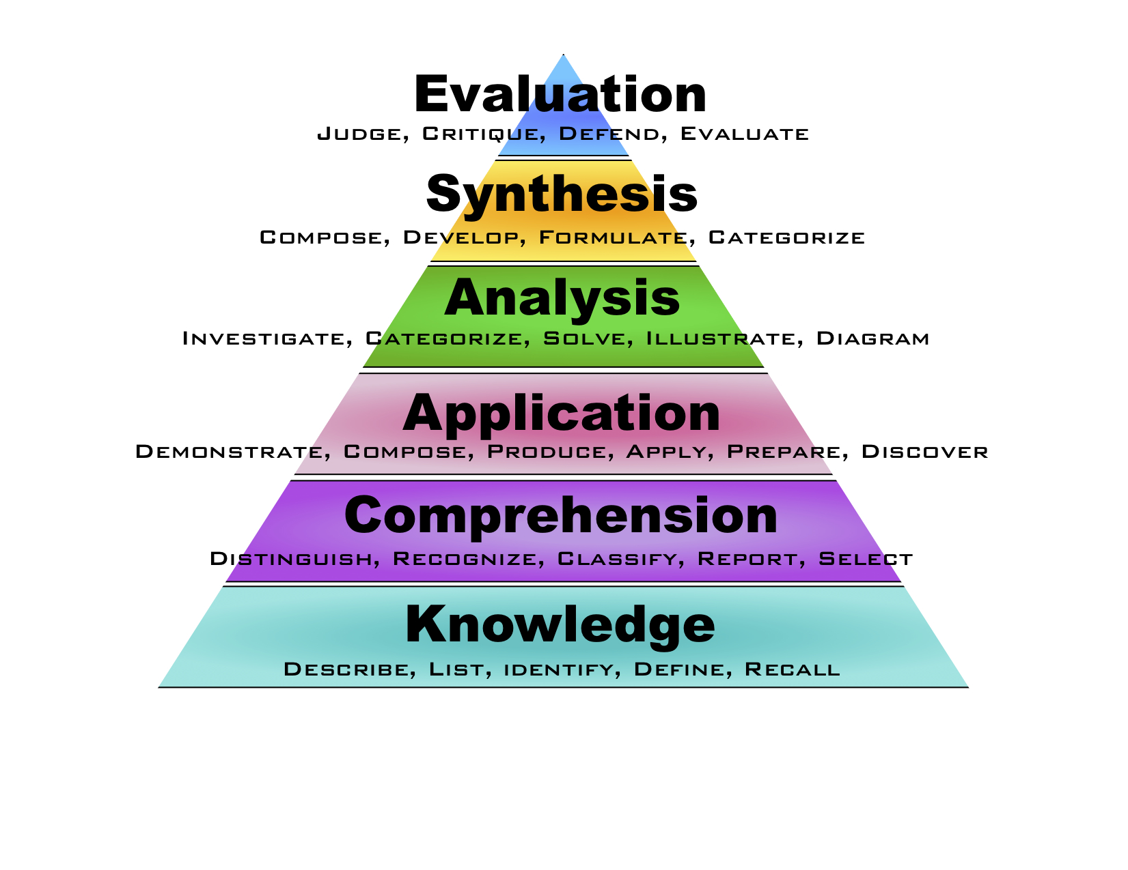
The Bloom's six categories of cognitive skills

Slide 30
The Bloom's six categories of cognitive skills
1. Remember/Reiterate - performance is based on recognition of a seen example(s);
2. Understand/Summarise - performance summarizes information already known/given;
3. Apply/Illustrate - performance extrapolates from seen examples to new ones by applying rules;
4. Analyze/Predict - performance requires analysis and prediction, using rules;
5. Create/ Synthetise - performance yields something innovative and novel, creating, describing and justifying something new from existing things/ideas;

Slide 31
How can we use the Bloom's hierarchy of cognitive skills in teaching and training?
We can use the Bloom's taxonomy to align instruction with learners' levels of complexity of thinking (and experience).
How? We can use it to:
identify teaching objectives and learning outcomes
design instruction and learning experiences
assess learning

Slide 32
How can we use the Bloom's hierarchy of cognitive skills in teaching and training?
We can use the Bloom's taxonomy to align instruction with learners' levels of complexity of thinking (and experience).
How? We can use it to:
identify teaching objectives and learning outcomes
design instruction and learning experiences
assess learning

Slide 33
Teaching objectives and Learning Outcomes

Slide 34
In order to write learning outcomes, you can use the following scheme:
1) Think about what learners will be able to do by the end of instruction
2) Use the sentence: By the end of the lesson (session/course/instruction) the learner will be able to......... OR The successful learner will be able to......
3) Replace dots with a verb that you can assess (name, explain, solve, distinguish, etc.).
4) Avoid verbs that are open to many interpretations: appreciate, have faith in, know, learn, understand, believe
5) Keep in mind that learning outcomes can be as specific as you want. You may even think about a different learning outcome for each task you assign to learners.

Slide 35
In order to write learning outcomes, you can use the following scheme:
1) Think about what learners will be able to do by the end of instruction
2) Use the sentence: By the end of the lesson (session/course/instruction) the learner will be able to......... OR The successful learner will be able to......
3) Replace dots with a verb that you can assess (name, explain, solve, distinguish, etc.).
4) Avoid verbs that are open to many interpretations: appreciate, have faith in, know, learn, understand, believe
5) Keep in mind that learning outcomes can be as specific as you want. You may even think about a different learning outcome for each task you assign to learners.

Slide 36
In order to write learning outcomes, you can use the following scheme:
1) Think about what learners will be able to do by the end of instruction
2) Use the sentence: By the end of the lesson (session/course/instruction) the learner will be able to......... OR The successful learner will be able to......
3) Replace dots with a verb that you can assess (name, explain, solve, distinguish, etc.).
4) Avoid verbs that are open to many interpretations: appreciate, have faith in, know, learn, understand, believe
5) Keep in mind that learning outcomes can be as specific as you want. You may even think about a different learning outcome for each task you assign to learners.

Slide 37
In order to write learning outcomes, you can use the following scheme:
1) Think about what learners will be able to do by the end of instruction
2) Use the sentence: By the end of the lesson (session/course/instruction) the learner will be able to......... OR The successful learner will be able to......
3) Replace dots with a verb that you can assess (name, explain, solve, distinguish, etc.).
4) Avoid verbs that are open to many interpretations: appreciate, have faith in, know, learn, understand, believe
5) Keep in mind that learning outcomes can be as specific as you want. You may even think about a different learning outcome for each task you assign to learners.

Slide 38
In order to write learning outcomes, you can use the following scheme:
1) Think about what learners will be able to do by the end of instruction
2) Use the sentence: By the end of the lesson (session/course/instruction) the learner will be able to......... OR The successful learner will be able to......
3) Replace dots with a verb that you can assess (name, explain, solve, distinguish, etc.).
4) Avoid verbs that are open to many interpretations: appreciate, have faith in, know, learn, understand, believe
5) Keep in mind that learning outcomes can be as specific as you want. You may even think about a different learning outcome for each task you assign to learners.

Slide 39
Measurable verbs to assist you in writing and assessing learning outcomes
https://github.com/ppalagi/EXCELERATE-TtT/blob/master/docs/learning-outcomes.md

Slide 40
Teaching objectives and Learning Outcomes
Challenge
Write a Teaching Objective AND a Learning Outcome for a lesson or a session you usually deliver.

Slide 41
The acquisition of skills: novice, competent practicionner, expert

Slide 42
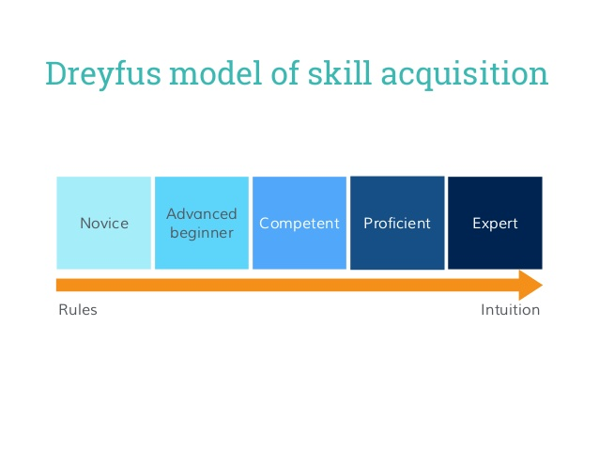

Slide 43
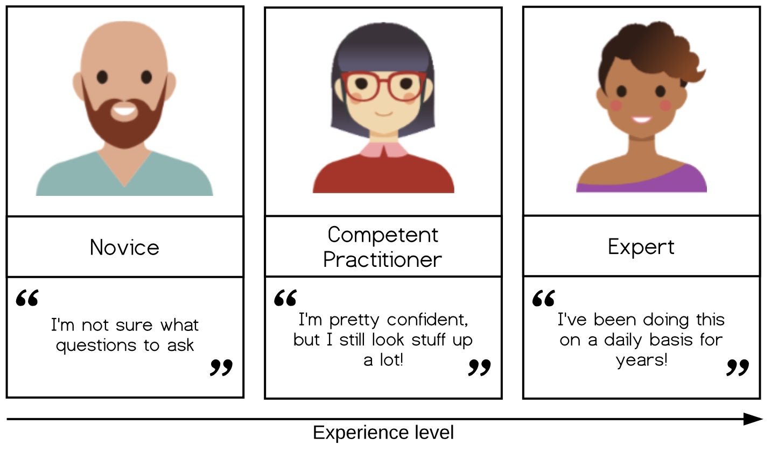

Slide 44
The acquisition of skills: novice, competent practicionner, expert
Novice: someone who doesn’t even know what questions to ask
Competent practitioner: someone who has enough understanding for everyday purposes
Expert: someone who can easily handle situations that are out of the ordinary

Slide 45
The acquisition of skills: novice, competent practicionner, expert
Challenge
Think about a topic/field you feel you are a novice, a topic you feel you are a competent practitioner, and one you feel an expert, and share this with us.

Slide 46
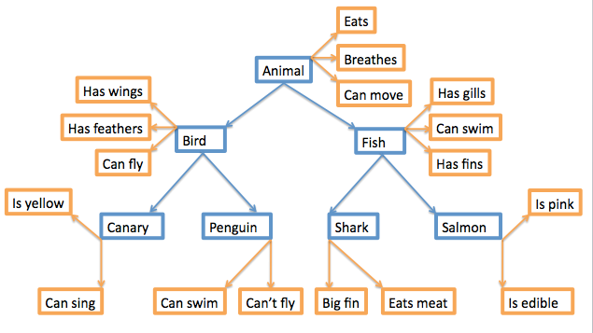
Mental models
A mental model is a collection of concepts and facts, along with the relationships between those concepts, that a person has about a topic or field.

Slide 47
Novice, competent practitioner, expert: in what do they differ?
Challenge: What are the main differences between a novice and an expert in terms of knowledge and learning?
Think about yourself as a learner.
How did you feel about something new when you were a student? How was to be a novice? Can you remember it?
How do you feel today when you have/want to learn something completely new to you? Does it happen sometimes?
How do you feel when you have to learn something new *in your field*? Namely, something that is an extension of your current knowledge about something (e.g. you know well a given OS and you need to learn how a different OS works).
Write at least two things in which novices and experts differ.

Slide 48
Learners' prior knowledge and misconceptions
P1: How can prior knowledge hinder learning?
Misconceptions
Simple factual errors
Broken models
Fundamental beliefs

Slide 49
Working memory, long term memory and learning
Attention
Working memory
(site of awareness and thinking)
Environment
Remembering
Learning
Long-term memory
(factual knowledge and procedural knowledge)

Slide 50
Working memory, long term memory and learning
Attention
Working memory
(site of awareness and thinking)
Environment
Component of your mind (synonymous of consciousness). It is where thinking occurs. It is the part of your mind where you are aware of what is around you.
Full of things to see and hear, problem to be solved etc.
Remembering
Learning
Long-term memory
(factual knowledge and procedural knowledge)
Vast storehouse in which you mantain your factual knowledge of the world. Information in long-term memory resides outside of awareness.

Slide 51
Long-term vs working memory
Long-term memory is slow to access but it is essentially unbounded
Working memory is very fast but has very limited space. Several experiments showed that we can hold in the working memory up to 7 +/- 2 items.
https://cat.xula.edu/thinker/memory/working/serial
The fact that working memory has limited space, implies that thinking becomes increasingly difficult as working memory gets crowded.

Slide 52
What can we do to make room in working memory?
Increase our background knowledge
Avoid extraneous cognitive load

Slide 53
X C N
N P H
D F B
I C I
A N C
A A X

Slide 55
X
C N N
P H D
F B I
C I A
N C A A
X

Slide 56
Other factors facilitating memory
things that create an emotional reaction will be better remembered, but emotion is not necessary for learning (and it is definitely not sufficient!)
if you don't pay attention to something, you can't learn it
repetition helps but repetition alone is not sufficient
wanting to remember something has little or no effect
thinking about meaning is good for memory
practice makes learning long lasting
spaced practice is of great benefit for memory

Slide 57
Other factors facilitating memory
things that create an emotional reaction will be better remembered, but emotion is not necessary for learning (and it is definitely not sufficient!)
if you don't pay attention to something, you can't learn it
repetition helps but repetition alone is not sufficient
wanting to remember something has little or no effect
thinking about meaning is good for memory
practice makes learning long lasting
spaced practice is of great benefit for memory

Slide 58
Other factors facilitating memory
things that create an emotional reaction will be better remembered, but emotion is not necessary for learning (and it is definitely not sufficient!)
if you don't pay attention to something, you can't learn it
repetition helps but repetition alone is not sufficient
wanting to remember something has little or no effect
thinking about meaning is good for memory
practice makes learning long lasting
spaced practice is of great benefit for memory

Slide 59
Other factors facilitating memory
things that create an emotional reaction will be better remembered, but emotion is not necessary for learning (and it is definitely not sufficient!)
if you don't pay attention to something, you can't learn it
repetition helps but repetition alone is not sufficient
wanting to remember something has little or no effect
thinking about meaning is good for memory
practice makes learning long lasting
spaced practice is of great benefit for memory

Slide 60
Other factors facilitating memory
things that create an emotional reaction will be better remembered, but emotion is not necessary for learning (and it is definitely not sufficient!)
if you don't pay attention to something, you can't learn it
repetition helps but repetition alone is not sufficient
wanting to remember something has little or no effect
thinking about meaning is good for memory
practice makes learning long lasting
spaced practice is of great benefit for memory

Slide 61
Other factors facilitating memory
things that create an emotional reaction will be better remembered, but emotion is not necessary for learning (and it is definitely not sufficient!)
if you don't pay attention to something, you can't learn it
repetition helps but repetition alone is not sufficient
wanting to remember something has little or no effect
thinking about meaning is good for memory
practice makes learning long lasting
spaced practice is of great benefit for memory

Slide 62
Other factors facilitating memory
things that create an emotional reaction will be better remembered, but emotion is not necessary for learning (and it is definitely not sufficient!)
if you don't pay attention to something, you can't learn it
repetition helps but repetition alone is not sufficient
wanting to remember something has little or no effect
thinking about meaning is good for memory
practice makes learning long lasting
spaced practice is of great benefit for memory

Slide 63
Cognitive load
Cognitive load refers to the total amount of mental effort being used in the working memory
Intrinsic cognitive load is the effort associated with a specific topic
Germane cognitive load is the (desirable) mental effort required to create linkages between new information and old (which is one of the things that distinguishes learning from memorisation)
Extraneous cognitive load is everything else that distracts or gets in the way.

Slide 64
Cognitive load
Cognitive load refers to the total amount of mental effort being used in the working memory
Intrinsic cognitive load is the effort associated with a specific topic
Germane cognitive load is the (desirable) mental effort required to create linkages between new information and old (which is one of the things that distinguishes learning from memorisation)
Extraneous cognitive load is everything else that distracts or gets in the way.

Slide 65
Cognitive load
Cognitive load refers to the total amount of mental effort being used in the working memory
Intrinsic cognitive load is the effort associated with a specific topic
Germane cognitive load is the (desirable) mental effort required to create linkages between new information and old (which is one of the things that distinguishes learning from memorisation)
Extraneous cognitive load is everything else that distracts or gets in the way.

Slide 66
Cognitive load
Cognitive load refers to the total amount of mental effort being used in the working memory
Intrinsic cognitive load is the effort associated with a specific topic
Germane cognitive load is the (desirable) mental effort required to create linkages between new information and old (which is one of the things that distinguishes learning from memorisation)
Extraneous cognitive load is everything else that distracts or gets in the way.

Slide 67
Split attention effect

Slide 68
The Learning Environment

Slide 69
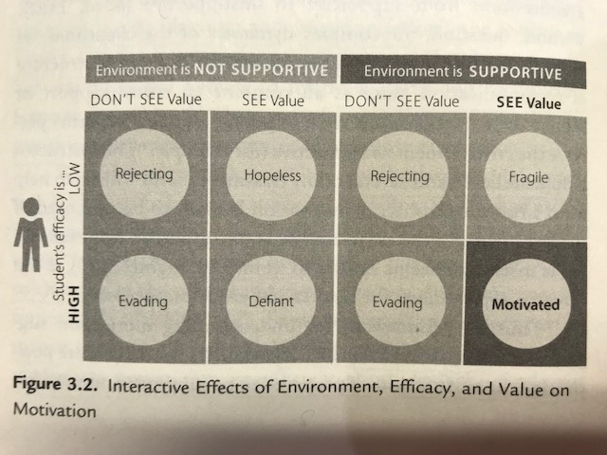
Motivation

Slide 70
Value
attainment value
satisfaction that one gains from mastery and accomplishment of a goal or task
intrinsic value
the satisfaction that one gains simply from doing the task rather than from a particular outcome of the task
It is the source of intrinsic motivation
instrumental value/extrinsic rewards
praise
public recognition
money
material goods
an interesting career
a high-status job, etc.)

Slide 71
Efficacy
positive outcomes expectancies for success
growth vs fixed mindset
Efficacy expetancies represent the belief that one is capable of identifying, organising, initiating, and executing a course of action that will bring about a desired outcome (Bandura, 1997).
In order to hold a positive expectancy for success, learners must not only believe that doing the assigned work can earn a passing grade (growth mindset), they must also believe that they are capable of doing the work necessary to earn a passing grade

Slide 72
Efficacy
positive outcomes expectancies for success
growth vs fixed mindset
Efficacy expetancies represent the belief that one is capable of identifying, organising, initiating, and executing a course of action that will bring about a desired outcome (Bandura, 1997).
In order to hold a positive expectancy for success, learners must not only believe that doing the assigned work can earn a passing grade (growth mindset), they must also believe that they are capable of doing the work necessary to earn a passing grade

Slide 73
Environment
complex dynamics of the classroom
its tone
the interpersonal forces at play
the nature and structure of communication patterns.
e.g. "The instructor is approachable and several of my classmates seem willing to help me if I run into troubles".

Slide 74
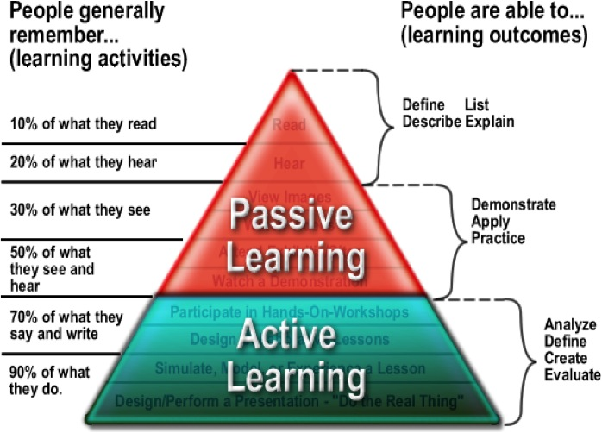

Slide 75
Mazur's video on Peer Instruction for Active Learning

Slide 76
Session 2
Training techniques that can be used to enhance learner engagement and participation

Slide 77
What makes a good training session?
Challenge 1: Training you have been involved in...
What makes a good training session?
What makes a bad training session?
Think of an example of each that you have participated in and list your thoughts…

Slide 78
What makes a good trainer?
Challenge 2: What makes a good trainer?
Discuss it in pairs and write down which characteristics you think a good trainer should have
Identify two essential characteristics that good teachers have in common. Discuss with your partner.

Slide 79
What makes a good trainer?
Knowledge of subject
Clear aims for session outcomes
Confidence in delivery
Appropriate delivery
Listens to trainees
Flexible – can change pace / depth if required
Approachable
Engaging

Slide 80
According to experiment described in (Willingham, 2009), effective teachers have two qualities:
they are able to connect personally with students, and
they organise the material in a way that makes it interesting and easy to understand (the class is well organised).

Slide 81
The GOBLET skills matrix for trainers
The TtT taskforce of the Global Organisation for Bioinformatics Learning, Education and Training (GOBLET), developed a skills matrix for trainiers.
It aims to provide an overview of the major skills required to be a good trainer

Slide 82
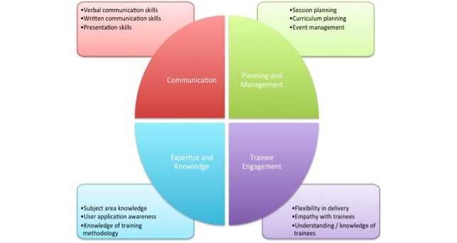

Slide 83
The GOBLET skills matrix for trainers
Challenge
Try to reflect on your current skills and how they fit with this matrix
Then share your thoughts with us
goo.gl/18dcto

Slide 84
Motivation and demotivation

Slide 85
Strategies to establish value
Connect the material to students’ interests
Provide authentic, real-world tasks
Show relevance to students’ current academic lives
Demonstrate the relevance of higher-level skills to students’ future professional lives
Identify and reward what you value
Show your own passion and enthusiasm for the discipline
Strategies to build positive expectations
Ensure alignment of objectives, assessments, and instructional strategies
Identify an appropriate level of challenge

Slide 86
Strategies to establish value
Connect the material to students’ interests
Provide authentic, real-world tasks
Show relevance to students’ current academic lives
Demonstrate the relevance of higher-level skills to students’ future professional lives
Identify and reward what you value
Show your own passion and enthusiasm for the discipline
Strategies to build positive expectations
Ensure alignment of objectives, assessments, and instructional strategies
Identify an appropriate level of challenge

Slide 87
Strategies to establish value
Connect the material to students’ interests
Provide authentic, real-world tasks
Show relevance to students’ current academic lives
Demonstrate the relevance of higher-level skills to students’ future professional lives
Identify and reward what you value
Show your own passion and enthusiasm for the discipline
Strategies to build positive expectations
Ensure alignment of objectives, assessments, and instructional strategies
Identify an appropriate level of challenge

Slide 88
Strategies to establish value
Connect the material to students’ interests
Provide authentic, real-world tasks
Show relevance to students’ current academic lives
Demonstrate the relevance of higher-level skills to students’ future professional lives
Identify and reward what you value
Show your own passion and enthusiasm for the discipline
Strategies to build positive expectations
Ensure alignment of objectives, assessments, and instructional strategies
Identify an appropriate level of challenge

Slide 89
Strategies to establish value
Connect the material to students’ interests
Provide authentic, real-world tasks
Show relevance to students’ current academic lives
Demonstrate the relevance of higher-level skills to students’ future professional lives
Identify and reward what you value
Show your own passion and enthusiasm for the discipline
Strategies to build positive expectations
Ensure alignment of objectives, assessments, and instructional strategies
Identify an appropriate level of challenge

Slide 90
Strategies to establish value
Connect the material to students’ interests
Provide authentic, real-world tasks
Show relevance to students’ current academic lives
Demonstrate the relevance of higher-level skills to students’ future professional lives
Identify and reward what you value
Show your own passion and enthusiasm for the discipline
Strategies to build positive expectations
Ensure alignment of objectives, assessments, and instructional strategies
Identify an appropriate level of challenge

Slide 91
Strategies to establish value
Connect the material to students’ interests
Provide authentic, real-world tasks
Show relevance to students’ current academic lives
Demonstrate the relevance of higher-level skills to students’ future professional lives
Identify and reward what you value
Show your own passion and enthusiasm for the discipline
Strategies to build positive expectations
Ensure alignment of objectives, assessments, and instructional strategies
Identify an appropriate level of challenge

Slide 92
Strategies to establish value
Connect the material to students’ interests
Provide authentic, real-world tasks
Show relevance to students’ current academic lives
Demonstrate the relevance of higher-level skills to students’ future professional lives
Identify and reward what you value
Show your own passion and enthusiasm for the discipline
Strategies to build positive expectations
Ensure alignment of objectives, assessments, and instructional strategies
Identify an appropriate level of challenge

Slide 93
Strategies to establish value
Connect the material to students’ interests
Provide authentic, real-world tasks
Show relevance to students’ current academic lives
Demonstrate the relevance of higher-level skills to students’ future professional lives
Identify and reward what you value
Show your own passion and enthusiasm for the discipline
Strategies to build positive expectations
Ensure alignment of objectives, assessments, and instructional strategies
Identify an appropriate level of challenge

Slide 94
Strategies to establish value
Create assignments that provide the appropriate level of challenge
Provide early success opportunities
Articulate your expectations
Provide rubrics
Provide targeted feedback
Be fair
Educate students about the ways we explain success and failure
Describe effective study strategies
Strategies for self-efficacy
Provide flexibility and control
Give students an opportunity to reflect

Slide 95
Strategies to establish value
Create assignments that provide the appropriate level of challenge
Provide early success opportunities
Articulate your expectations
Provide rubrics
Provide targeted feedback
Be fair
Educate students about the ways we explain success and failure
Describe effective study strategies
Strategies for self-efficacy
Provide flexibility and control
Give students an opportunity to reflect

Slide 96
Strategies to establish value
Create assignments that provide the appropriate level of challenge
Provide early success opportunities
Articulate your expectations
Provide rubrics
Provide targeted feedback
Be fair
Educate students about the ways we explain success and failure
Describe effective study strategies
Strategies for self-efficacy
Provide flexibility and control
Give students an opportunity to reflect

Slide 97
Strategies to establish value
Create assignments that provide the appropriate level of challenge
Provide early success opportunities
Articulate your expectations
Provide rubrics
Provide targeted feedback
Be fair
Educate students about the ways we explain success and failure
Describe effective study strategies
Strategies for self-efficacy
Provide flexibility and control
Give students an opportunity to reflect

Slide 98
Strategies to establish value
Create assignments that provide the appropriate level of challenge
Provide early success opportunities
Articulate your expectations
Provide rubrics
Provide targeted feedback
Be fair
Educate students about the ways we explain success and failure
Describe effective study strategies
Strategies for self-efficacy
Provide flexibility and control
Give students an opportunity to reflect

Slide 99
Strategies to establish value
Create assignments that provide the appropriate level of challenge
Provide early success opportunities
Articulate your expectations
Provide rubrics
Provide targeted feedback
Be fair
Educate students about the ways we explain success and failure
Describe effective study strategies
Strategies for self-efficacy
Provide flexibility and control
Give students an opportunity to reflect

Slide 100
Strategies to establish value
Create assignments that provide the appropriate level of challenge
Provide early success opportunities
Articulate your expectations
Provide rubrics
Provide targeted feedback
Be fair
Educate students about the ways we explain success and failure
Describe effective study strategies
Strategies for self-efficacy
Provide flexibility and control
Give students an opportunity to reflect

Slide 101
Strategies to establish value
Create assignments that provide the appropriate level of challenge
Provide early success opportunities
Articulate your expectations
Provide rubrics
Provide targeted feedback
Be fair
Educate students about the ways we explain success and failure
Describe effective study strategies
Strategies for self-efficacy
Provide flexibility and control
Give students an opportunity to reflect

Slide 102
Strategies to establish value
Create assignments that provide the appropriate level of challenge
Provide early success opportunities
Articulate your expectations
Provide rubrics
Provide targeted feedback
Be fair
Educate students about the ways we explain success and failure
Describe effective study strategies
Strategies for self-efficacy
Provide flexibility and control
Give students an opportunity to reflect

Slide 103
Strategies to establish value
Create assignments that provide the appropriate level of challenge
Provide early success opportunities
Articulate your expectations
Provide rubrics
Provide targeted feedback
Be fair
Educate students about the ways we explain success and failure
Describe effective study strategies
Strategies for self-efficacy
Provide flexibility and control
Give students an opportunity to reflect

Slide 104
Strategies to establish value
Create assignments that provide the appropriate level of challenge
Provide early success opportunities
Articulate your expectations
Provide rubrics
Provide targeted feedback
Be fair
Educate students about the ways we explain success and failure
Describe effective study strategies
Strategies for self-efficacy
Provide flexibility and control
Give students an opportunity to reflect

Slide 105
Things that an instructor shouldn't do in a course (from Carpentry Instructor Training)
Tell learners they are rubbish because they use Excel and/or Word don't modularize their code, etc.
Repeatedly make digs about Windows and praise Linux, e.g., say that the former is for amateurs.
Criticise GUI applications (and by implication their users) and describe command-line tools as the One True Way.
Dive into complex or detailed technical discussion with the one or two people in the audience who clearly don't actually need to be there.
Pretend to know more than you do. People will actually trust you more if you are frank about the limitations of your knowledge, and will be more likely to ask questions and seek help.
Use the J word ("just"). This signals the learner that the instructor thinks their problem is trivial and by extension that they therefore must be stupid for not being able to figure it out.

Slide 106
Examples of techniques that you can use to promote engagement in training
Establish teamwork by agreement
Introduce blended multi-media materials
Make frequent use of instant feedback to monitor and to induce self-assessment
Offer participatory stimuli (prizes, gamifications)
Let learners doing recaps (in the morning about the day before, at the end of sessions, etc)
Introduce physical exercise (e.g. at the beginning of after-lunch sessions): this is good for both physical and mental health
Introduce short, relaxing breaks (e.g. one minute meditation)
Assign tasks to groups (e.g. Python libraries) and let the groups present the result of their work

Slide 107
Activities and attitudes the instructor should keep to a minimum
lecturing
individual work out
providing answers before letting participants doing it
keeping the same pace for long time
using a monotone modality of content delivery (including the tone of the voice)
showing no enthusiasm

Slide 108
Activities and attitudes the instructor should promote
listening
questions asking
challenging learners
group discussions/brainstorming
work in pairs/groups
problem solving
peer instruction (using sticky notes, see below Carpentry teaching practices)
participants' interaction/neworking
games
physical exercise
presentations by participants
mode/pace/activity frequent change

Slide 109
Gamification
Using games in training may be an effective technique in many aspects.
Games promote:
ice breaking
interactivity
networking
fun
pace discontinuity
relax

Slide 110
Introductions and wrap-ups
The importance of…

